Slide 1

A Cloud-Assisted Design for Autonomous Driving
Swarun Kumar
Shyamnath Gollakota and Dina Katabi
Notes:
Hi, I am Swarun Kumar from MIT. I am going to talk to you about a cloud-assisted design for autonomous driving.
This is joint work with my colleagues Shyam and Dina.

Slide 2
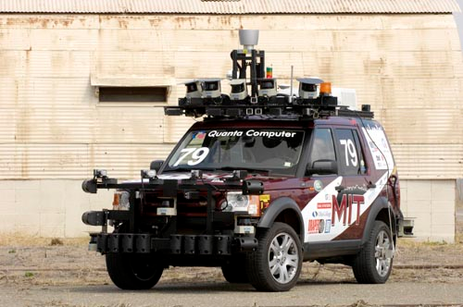
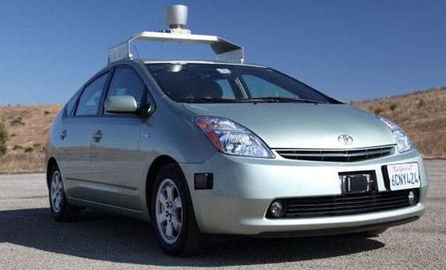
Lot of Interest in Autonomous Vehicles
DARPA Urban Challenge (Team MIT)
Google’s Autonomous Car
“Expect them on the road by 2020” – General Motors
Notes:
Recently, there has a been a lot of interest in autonomous vehicles
Perhaps the most well known initiative is the DARPA Urban challenge, in which, universities designed autonomous cars that can navigate on urban roads.
Another recent example is that of Google’s autonomous car which has traveled thousands of miles on public roads.
In fact, major companies are already building autonomous cars. And General Motors expects them on the road by 2020.

Slide 3
Benefits
Lower traffic congestion
Higher fuel efficiency
Improved human productivity
“Estimated to save $100B annually in US alone” – WPI’08
Notes:
These autonomous vehicles provide multiple benefits including:
Fewer traffic congestions,
much higher fuel efficiency and
improved productivity
Estimates show that these benefits are projected to save billions of dollars in the US alone.
All this is great, but there are still major technical challenges that we need to address.

Slide 4
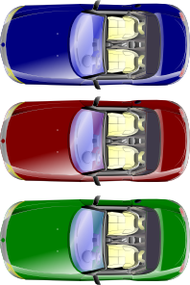

Challenge 1: Safely Detecting Hidden Objects
Sensors on a car can only see line of sight objects
Addressed in: “CarSpeak: A Content Centric Network for Autonomous Driving”, SIGCOMM 2012
Notes:
Firstly, Autonomous vehicles still can’t safely detect hidden objects.
In particular, sensors on any one autonomous car can only view objects in its direct line of sight.
This is a significant safety challenge, because today, an autonomous car may fail to detect a kid running around the corner
or a car pulling out of an occluded driveway.
In fact we addressed this precise challenge in our paper this SIGCOMM.

Slide 5
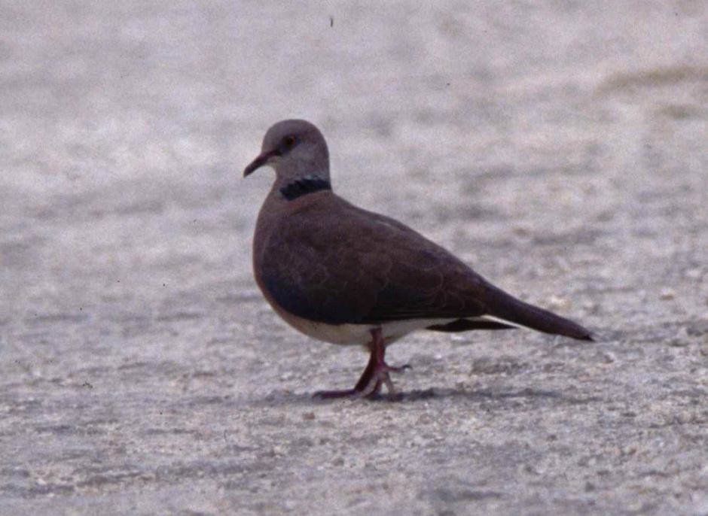
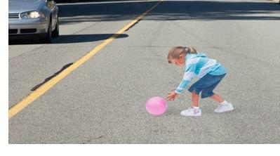
Challenge 2: Perception
Classifying different objects
Notes:
Another important challenge is perception of objects in the environment.
In particular, cars need to classify different objects in the environment. For example, it needs to distinguish a bird or balloon on the road, from a child, as each of these require different reactions from the car.
Additionally, it needs to track and predict the movement of objects in the environment. Sometimes, it would need to intelligently slow down, for example if it notices kids playing near the road.
Finally, it needs accurate localization, that is, infer where it is located in the road. GPS only gives you very coarse location information.
For a finer localization, cars need to locate fixed and known features of the road.
For example, a car can first locate fixed objects such as lamp posts, curbs, etc. whose global coordinates are known, and then use that information to find out where it is relative to the road.

Slide 6
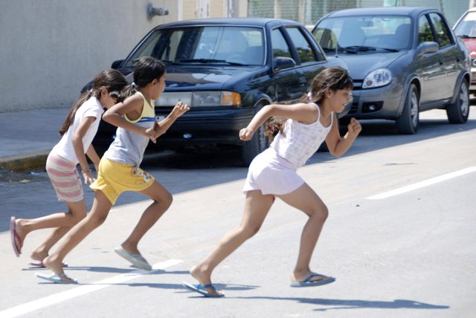
Challenge 2: Perception
Classifying different objects
Track and predict movement of objects
Notes:
Another important challenge is perception of objects in the environment.
In particular, cars need to classify different objects in the environment. For example, it needs to distinguish a bird or balloon on the road, from a child, as each of these require different reactions from the car.
Additionally, it needs to track and predict the movement of objects in the environment. Sometimes, it would need to intelligently slow down, for example if it notices kids playing near the road.
Finally, it needs accurate localization, that is, infer where it is located in the road. GPS only gives you very coarse location information.
For a finer localization, cars need to locate fixed and known features of the road.
For example, a car can first locate fixed objects such as lamp posts, curbs, etc. whose global coordinates are known, and then use that information to find out where it is relative to the road.

Slide 7
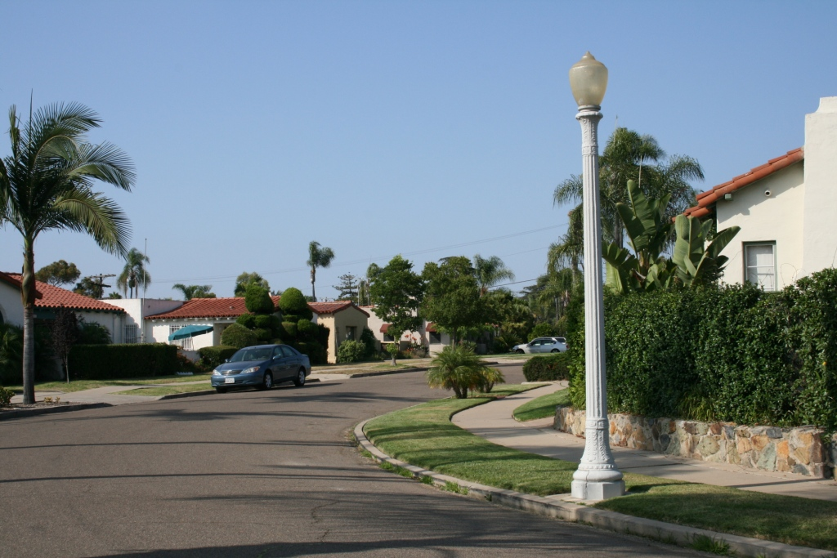
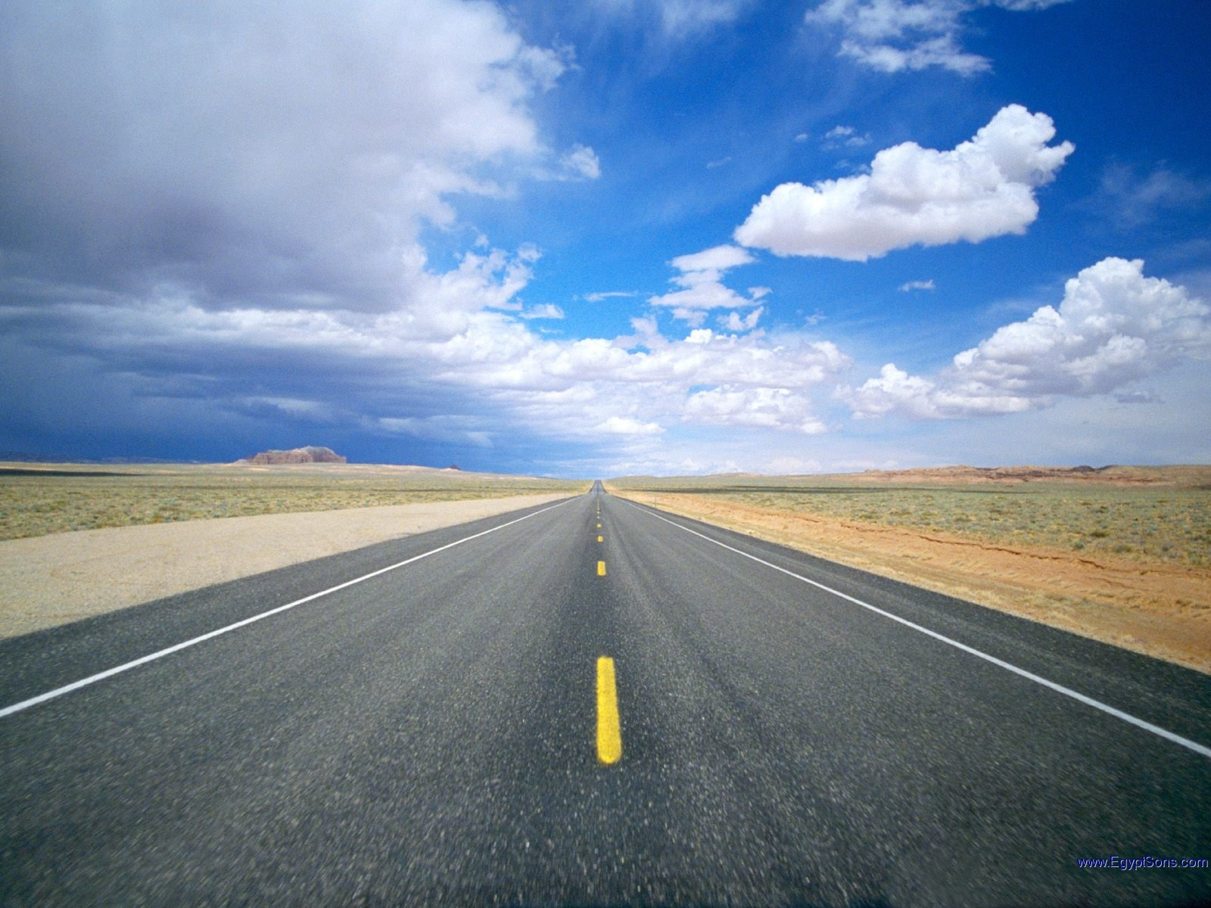
Challenge 2: Perception
Classifying different objects
Track and predict movement of objects
Accurate Localization
For fine localization: locate fixed known features
Notes:
Another important challenge is perception of objects in the environment.
In particular, cars need to classify different objects in the environment. For example, it needs to distinguish a bird or balloon on the road, from a child, as each of these require different reactions from the car.
Additionally, it needs to track and predict the movement of objects in the environment. Sometimes, it would need to intelligently slow down, for example if it notices kids playing near the road.
Finally, it needs accurate localization, that is, infer where it is located in the road. GPS only gives you very coarse location information.
For a finer localization, cars need to locate fixed and known features of the road.
For example, a car can first locate fixed objects such as lamp posts, curbs, etc. whose global coordinates are known, and then use that information to find out where it is relative to the road.

Slide 8
Perception requires huge storage, computation
Need to perform complex machine learning algorithms that operate on huge data sets
Need to store huge, detailed maps and images of the world – petabytes of data
“MIT’s DARPA Challenge car had a mini-datacenter inside. An extra AC was mounted on top to cool it!”
Notes:
Perception, however, requires a huge amount of storage and computation.
Cars need to perform complex machine learning algorithms that operate on huge data sets.
In addition, they need to store huge detailed maps and images of the world, which amounts to petabytes of data.
Thus, perception requires fairly advanced processing capabilities. To give you an example, MIT’s DARPA Urban challenge car had almost a mini-data center inside costing hundreds of thousands of dollars. In fact it had very little extra space inside and pretty much had to be autonomous. In fact, the mounted an extra AC unit on top, just to cool it!

Slide 9
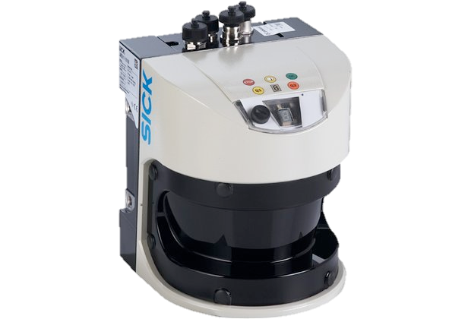
How can we overcome this challenge?
To the Cloud!
Cars share sensor data with cloud
Cloud
Notes:
So, the real question is how can autonomous vehicles deal with this challenge?
Of course, they can communicate with the cloud.
Autonomous vehicles and static infrastructure can share their sensor information with the cloud.
Further, the cloud performs complex processing to track obstacles and their movements.
And based on this processing, it advises cars on how to navigate the environment.

Slide 10
How can we overcome these challenges?
To the Cloud!
Cars share sensor data with cloud
Cloud performs complex processing to track obstacles and their movements.
Advises cars on how to navigate the environment
Notes:
So, the real question is how can autonomous vehicles deal with this challenge?
Of course, they can communicate with the cloud.
Autonomous vehicles and static infrastructure can share their sensor information with the cloud.
Further, the cloud performs complex processing to track obstacles and their movements.
And based on this processing, it advises cars on how to navigate the environment.

Slide 11
Benefits
Cloud has more storage & processing power
Can quickly identify pedestrians, other cars, etc.
Leverage these to provide improved paths
Cloud has access data beyond wireless range
Has aggregate view from all vehicles & infrastructure
Can report accidents, congestion, etc.
Notes:
Such an architecture provides multiple benefits.
Firstly, the cloud has significantly more storage and processing power.
Thus, the cloud can quickly identify objects in the environment in the vicinity of these cars, such as pedestrians and other cars.
It can then leverage all this data to suggest improved paths to cars.
Secondly, the cloud has greater access to sensor data beyond wireless range.
This is because has an aggregate view of sensor data from all vehicles and static infrastructure.
It can use this view to report situations such as accidents and congestion, occurring beyond the car’s sensor range.

Slide 12
Contributions
A cloud-assisted design for autonomous driving
Assists cars to avoid obstacles beyond a their wireless range
Suggests vehicles more efficient paths avoiding congestion and road blocks
Preliminary prototype implemented on real autonomous car
Notes:
In the rest of this talk, I will present our cloud-assisted design for autonomous driving.
Our system assists vehicles to avoid obstacles beyond a car’s wireless range
It also suggests to vehicles more efficient paths that avoid traffic congestion and road blocks.
We implemented and evaluated a preliminary prototype of our system on a real autonomous car.
So let’s see how our system works.

Slide 13
How do we design an architecture where the cloud gets data from multiple cars?
How do cars send sensor data over limited-bandwidth link?
3. How do we deal with high packet loss inherent to these links?
Notes:
For this, we need to answer three main questions.
First, how do we design an architecture where the cloud retrieves only important data?
Second, how do cars send their sensor data over wireless links which have limited bandwidth?
Third, how can we deal with high packet losses that are inherent to wireless links?

Slide 14
How do we design an architecture where the cloud gets data from multiple cars?
How do cars send sensor data over limited-bandwidth link?
3. How do we deal with high packet loss inherent to these links?
Notes:
So let’s first answer the first question.
How do we design an architecture where the cloud retrieves only important data?

Slide 15
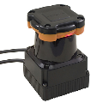
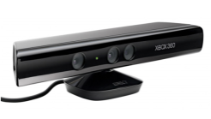
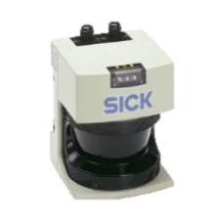
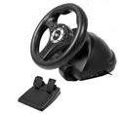
Primer on Autonomous Vehicles
Three modules:
Sensor 1
path
Controller
Sensor 2
Planner
Module
sensor
data
speed,
steering,
gear
Sensor n
Notes:
So to see how our system works, let me first give you a quick primer on the architecture of autonomous vehicles.
At a high level, autonomous navigation systems have three types of modules.
First, sensor modules generate streams of real-time data from onboard-sensors.
Second, the planner module which uses all this data to compute a safe path towards the car’s destination.
Finally, the controller which navigates the car along this path through speed and steering commands.

Slide 16
Primer on Autonomous Vehicles
Three modules:
Sensors: Provide data from onboard sensors
Sensor 1
path
Controller
Sensor 2
Planner
Module
sensor
data
speed,
steering,
gear
Sensor n
Notes:
So to see how our system works, let me first give you a quick primer on the architecture of autonomous vehicles.
At a high level, autonomous navigation systems have three types of modules.
First, sensor modules generate streams of real-time data from onboard-sensors.
Second, the planner module which uses all this data to compute a safe path towards the car’s destination.
Finally, the controller which navigates the car along this path through speed and steering commands.

Slide 17
Primer on Autonomous Vehicles
Three modules:
Sensors: Provide data from onboard sensors
Planner: Compute safe path to destination
Sensor 1
path
Controller
Sensor 2
Planner
Module
sensor
data
speed,
steering,
gear
Sensor n
Notes:
So to see how our system works, let me first give you a quick primer on the architecture of autonomous vehicles.
At a high level, autonomous navigation systems have three types of modules.
First, sensor modules generate streams of real-time data from onboard-sensors.
Second, the planner module which uses all this data to compute a safe path towards the car’s destination.
Finally, the controller which navigates the car along this path through speed and steering commands.

Slide 18
Primer on Autonomous Vehicles
Three modules:
Sensors: Provide data from onboard sensors
Planner: Compute safe path to destination
Controller: Navigate car along path
Sensor 1
path
Controller
Sensor 2
Planner
Module
sensor
data
speed,
steering,
gear
Sensor n
Notes:
So to see how our system works, let me first give you a quick primer on the architecture of autonomous vehicles.
At a high level, autonomous navigation systems have three types of modules.
First, sensor modules generate streams of real-time data from onboard-sensors.
Second, the planner module which uses all this data to compute a safe path towards the car’s destination.
Finally, the controller which navigates the car along this path through speed and steering commands.

Slide 19
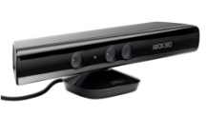
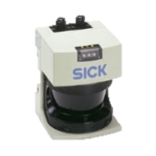
Cloud-Assisted Architecture
Cloud
Cloud’s Planner
Sensor data
Safe path
Sensor 1
Planner
Controller
Sensor 2
Problem: Cars collect huge amount of real-time data
→ Car should only send important data
Sensor n
Autonomous Vehicle
Notes:
So let’s see how our system fits in.
Our system implements an autonomous planner in the cloud which tracks the paths of all connected autonomous vehicles.
In particular, it obtains sensor data from all these vehicles as well as static infrastructure.
It aggregates this data to identify obstacles and objects that the car’s onboard sensors does not know about and suggests safe paths.
However, this architecture has a problem: Cars collect a huge, about Gb/s of real-time data. Hence they must use the wireless medium judiciously to send only required data.

Slide 20
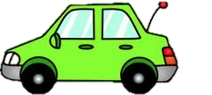
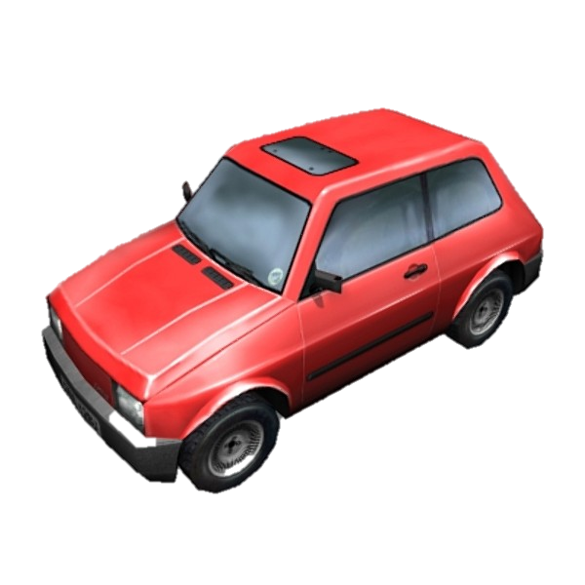
Cloud-Assisted Architecture
Cloud
Is path safe?
no
yes
Have data along path?
Find safe
path
no
Request for missing data
request
data
yes
alternate
path
proposed
path
Notes:
So let’s see how our system achieves this.
First, the car sends its proposed path to the destination to the cloud.
The cloud checks if it has enough sensor data along this path.
If yes, it moves on to analyze the data and check if the path is safe.
If not, It requests for any missing data from other cars.
The other cars respond to the cloud with the missing data.
The car now has sufficient information to check if the path is safe, and if so reports it to the car.
If it is not safe, the cloud runs a path planning algorithm to find and alternate path which is sent to the car.

Slide 21
How do we design an architecture where the cloud gets data from multiple cars?
How do cars send sensor data over limited-bandwidth link?
3. How do we deal with high packet loss inherent to these links?
Notes:
So now that we understand our system’s architecture, let us move on to our next question.
How do cars send sensor data over limited-bandwidth links to the cloud?

Slide 22
What is the data that sensors gather?
Sensor data helps cars find obstacle free paths to destination
Tell cars which parts of environment:
Are empty and safe to pass through
Are occupied and unsafe to pass through
z
X
Notes:
For this, we first understand what really is the data that sensors gather.
Basically, sensor data is any data that helps an autonomous car find obstacle free paths to safely get to its destination.
So it tells the car which parts of its environment….
… are empty and therefore safe to pass through.
.. And are occupied and therefore unsafe to pass through

Slide 23
What is the data that sensors gather?
Divide environment recursively into 8 cubes
0
0
0
0
0
0
0
0
0
0
0
0
0
0
→
0
→
0
0
0
0
→ …
0
0
0
0
0
0
0
0
Notes:
So to describe parts of the environment, we divide the environment recursively into 8 cubes as shown.
So all that we need to say about a cube is one bit – 0 if it’s empty or 1 if it’s occupied.
Of course if a cube is empty, everything cube inside it is also empty.
In contrast, if a cube is occupied, it doesn’t mean everything inside it is occupied. It just means that at least one cube inside it is occupied.

Slide 24
What is the data that sensors gather?
Divide environment recursively into 8 cubes
Each cube has one bit: Empty (0) or Occupied (1)
If cube is empty
all cubes inside are empty
0
0
0
0
0
→
0
0
0
Notes:
So to describe parts of the environment, we divide the environment recursively into 8 cubes as shown.
So all that we need to say about a cube is one bit – 0 if it’s empty or 1 if it’s occupied.
Of course if a cube is empty, everything cube inside it is also empty.
In contrast, if a cube is occupied, it doesn’t mean everything inside it is occupied. It just means that at least one cube inside it is occupied.

Slide 25
What Info does Autonomous Car Need?
Each cube has one bit: Empty (0) or Occupied (1)
If cube is empty
→ all cubes inside are empty
If cube is occupied
→ at least one cube inside is occupied
1
0
0
→
0
1
Notes:
So to describe parts of the environment, we divide the environment recursively into 8 cubes as shown.
So all that we need to say about a cube is one bit – 0 if it’s empty or 1 if it’s occupied.
Of course if a cube is empty, everything cube inside it is also empty.
In contrast, if a cube is occupied, it doesn’t mean everything inside it is occupied. It just means that at least one cube inside it is occupied.

Slide 26
Compactly Representing Data
Level 1 has 8 bits where 0-empty, 1-occupied
1
0
0
0
1
0
0
0
0
Notes:
So let’s see how we can use this method to compactly represent this data.
Let’s say that this is our cube of interest, and again, green refers to empty and red refers to occupied.
As with any other recursive structure, we can represent this recursion using a tree.
The first level in the tree representing this cube will have these 8 bits, where 0 refers to empty and 1 refers to occupied.
Now every empty cube is completely empty, none of these 0’s need to be expanded to the 2nd level of the tree.
Only the 1 is expanded, if we want to see inside this cube at more resolution.
Now as we zoom further into this cube, only 1’s need to be expanded and all 0’s will terminate.
Thus, we can use this tree representation to compress sensor data fairly efficiently.

Slide 27
Compactly Representing Data
Level 1 has 8 bits where 0-empty, 1-occupied
None of 0 nodes need to be expanded
1
0
0
0
1
0
0
0
0
Notes:
So let’s see how we can use this method to compactly represent this data.
Let’s say that this is our cube of interest, and again, green refers to empty and red refers to occupied.
As with any other recursive structure, we can represent this recursion using a tree.
The first level in the tree representing this cube will have these 8 bits, where 0 refers to empty and 1 refers to occupied.
Now every empty cube is completely empty, none of these 0’s need to be expanded to the 2nd level of the tree.
Only the 1 is expanded, if we want to see inside this cube at more resolution.
Now as we zoom further into this cube, only 1’s need to be expanded and all 0’s will terminate.
Thus, we can use this tree representation to compress sensor data fairly efficiently.

Slide 28
Compactly Representing Data
Level 1 has 8 bits where 0-empty, 1-occupied
None of 0 nodes need to be expanded
Expand 1 node to see inside at more resolution
1
0
0
0
1
0
0
0
0
0
0
1
0
0
0
0
0
Notes:
So let’s see how we can use this method to compactly represent this data.
Let’s say that this is our cube of interest, and again, green refers to empty and red refers to occupied.
As with any other recursive structure, we can represent this recursion using a tree.
The first level in the tree representing this cube will have these 8 bits, where 0 refers to empty and 1 refers to occupied.
Now every empty cube is completely empty, none of these 0’s need to be expanded to the 2nd level of the tree.
Only the 1 is expanded, if we want to see inside this cube at more resolution.
Now as we zoom further into this cube, only 1’s need to be expanded and all 0’s will terminate.
Thus, we can use this tree representation to compress sensor data fairly efficiently.

Slide 29
Compactly Representing Data
Level 1 has 8 bits where 0-empty, 1-occupied
None of 0 nodes need to be expanded
Expand 1 node to see inside at more resolution
1
0
0
0
1
0
0
0
0
0
0
1
0
0
0
0
0
Tree representation provides a compressed representation of sensor data
0
0
1
0
0
0
0
1
Notes:
So let’s see how we can use this method to compactly represent this data.
Let’s say that this is our cube of interest, and again, green refers to empty and red refers to occupied.
As with any other recursive structure, we can represent this recursion using a tree.
The first level in the tree representing this cube will have these 8 bits, where 0 refers to empty and 1 refers to occupied.
Now every empty cube is completely empty, none of these 0’s need to be expanded to the 2nd level of the tree.
Only the 1 is expanded, if we want to see inside this cube at more resolution.
Now as we zoom further into this cube, only 1’s need to be expanded and all 0’s will terminate.
Thus, we can use this tree representation to compress sensor data fairly efficiently.

Slide 30
How do we design an architecture where the cloud gets data from multiple cars?
How do cars send sensor data over limited-bandwidth link?
3. How do we deal with high packet loss inherent to these links?
Notes:
Finally, let’s respond to our third question.
How do we deal with high packet loss inherent to these wireless links?

Slide 31
How do we deal with packet loss?
Tree divided into packets and sent
1
0
0
0
1
0
0
0
0
0
0
1
0
0
0
0
0
0
0
1
0
0
0
0
1
Notes:
To send information, each car divides the tree into a number of packets and send them over its wireless link to the cloud.
However, the link to the cloud may fail, leading to packet loss.
So let’s say the second packet was lost in this figure.
The problem is that loss of this single packet, in this scenario, can completely destroy the tree structure, leading to the entire tree being decoded erroneously.

Slide 32
How do we deal with packet loss?
Tree divided into packets and sent
Links to the cloud may fail → packet loss
1
0
0
0
1
0
0
0
0
0
0
1
0
0
0
0
0
0
0
1
0
0
0
0
1
Notes:
To send information, each car divides the tree into a number of packets and send them over its wireless link to the cloud.
However, the link to the cloud may fail, leading to packet loss.
So let’s say the second packet was lost in this figure.
The problem is that loss of this single packet, in this scenario, can completely destroy the tree structure, leading to the entire tree being decoded erroneously.

Slide 33
How do we deal with packet loss?
Tree divided into packets and sent
Links to the cloud may fail → packet loss
1
0
0
0
1
0
0
?
?
?
?
?
?
?
?
0
0
0
0
1
0
0
0
0
1
Notes:
To send information, each car divides the tree into a number of packets and send them over its wireless link to the cloud.
However, the link to the cloud may fail, leading to packet loss.
So let’s say the second packet was lost in this figure.
The problem is that loss of this single packet, in this scenario, can completely destroy the tree structure, leading to the entire tree being decoded erroneously.

Slide 34
How do we deal with packet loss?
Tree divided into packets and sent
Links to the cloud may fail → packet loss
Loss of single packet destroys tree structure
1
0
0
0
1
0
0
0
0
0
0
1
0
0
0
0
1
Notes:
To send information, each car divides the tree into a number of packets and send them over its wireless link to the cloud.
However, the link to the cloud may fail, leading to packet loss.
So let’s say the second packet was lost in this figure.
The problem is that loss of this single packet, in this scenario, can completely destroy the tree structure, leading to the entire tree being decoded erroneously.

Slide 35
Solution: Make packets self-contained
Each packet is sub-tree derived from root
Can reconstruct independent of other packets
1
0
0
0
1
0
0
0
0
0
0
1
0
0
0
0
0
0
0
1
0
0
0
0
1
Loss of packet → Loss of resolution as opposed to complete loss of information
Notes:
Our solution to make each packet of the tree self-contained.
In particular, each packet is a completely independent sub-tree of the tree derived from the root.
This allows each such sub-tree to be reconstructed independent from other packets.
Thus, loss of a single packet results in loss of resolution, as opposed to complete loss of information.

Slide 36
Empirical Results
Notes:
So, now let us see how our system performs in practice

Slide 37
Implementation
Implemented in Robot OS (ROS)
Integrated with MIT’s Path Planner from DARPA challenge
Notes:
We implemented our system in ROS – the Robot Operating system. This enables our system to be easily integrated with various autonomous vehicle and robotic systems.
We integrated our system with MIT’s Path Planner from the DARPA Urban challenge.

Slide 38
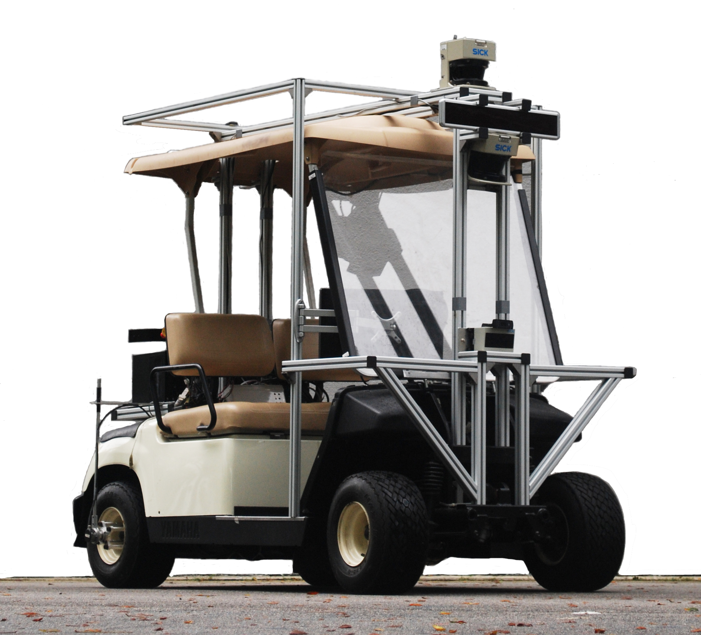
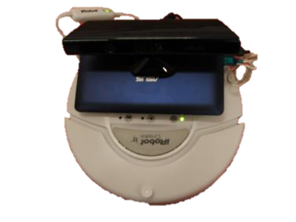
Testbed
Instrumented Yamaha car with laser sensors
Roomba Robots using Kinect sensors along road
Campus-like environment with pedestrians
Notes:
Our test bed uses an instrumented Yamaha car that was equipped with SICK and Hokuyo laser sensors.
Additionally, we place roomba robots equipped with Kinect sensors placed at various locations along the road.
We evaluated our system in a campus like environment where the car needs to detect pedestrians and other vehicles

Slide 39
Experiment 1: Resilience to packet loss
Rate at which data is received (s⁻¹)
Loss Rate
Notes:
In our first experiment, we evaluate how the link between an autonomous vehicle and the cloud is affected by packet loss.
In each experiment we measure the rate at which sensor data is received. [pause]
We repeat the experiment by increasing the loss rate of the link between the vehicle and the cloud.
First, we send uncompressed raw data. The received data rate is poor, but degrades linearly with increasing loss rate.
Next, we send data compressed using our tree structure. While this achieves significant compression when there is 0 loss, the received data rate falls rapidly upon increasing packet loss. This is because even a single packet loss can affect other packets in the tree.
Finally, we evaluate our system.
Clearly, our system achieves graceful degradation of resolution upon packet loss, without significantly compromising on compression.

Slide 40
Experiment 1: Resilience to packet loss
Rate at which data is received (s⁻¹)
Uncompressed
Loss Rate
Notes:
In our first experiment, we evaluate how the link between an autonomous vehicle and the cloud is affected by packet loss.
In each experiment we measure the rate at which sensor data is received. [pause]
We repeat the experiment by increasing the loss rate of the link between the vehicle and the cloud.
First, we send uncompressed raw data. The received data rate is poor, but degrades linearly with increasing loss rate.
Next, we send data compressed using our tree structure. While this achieves significant compression when there is 0 loss, the received data rate falls rapidly upon increasing packet loss. This is because even a single packet loss can affect other packets in the tree.
Finally, we evaluate our system.
Clearly, our system achieves graceful degradation of resolution upon packet loss, without significantly compromising on compression.

Slide 41
Experiment 1: Resilience to packet loss
Rate at which data is received (s⁻¹)
Tree Compression
Uncompressed
Loss Rate
Notes:
In our first experiment, we evaluate how the link between an autonomous vehicle and the cloud is affected by packet loss.
In each experiment we measure the rate at which sensor data is received. [pause]
We repeat the experiment by increasing the loss rate of the link between the vehicle and the cloud.
First, we send uncompressed raw data. The received data rate is poor, but degrades linearly with increasing loss rate.
Next, we send data compressed using our tree structure. While this achieves significant compression when there is 0 loss, the received data rate falls rapidly upon increasing packet loss. This is because even a single packet loss can affect other packets in the tree.
Finally, we evaluate our system.
Clearly, our system achieves graceful degradation of resolution upon packet loss, without significantly compromising on compression.

Slide 42
Experiment 1: Resilience to packet loss
Our System
Rate at which data is received (s⁻¹)
4.5 x
Tree Compression
Uncompressed
Our system achieves graceful degradation of resolution upon packet loss
Loss Rate
Notes:
In our first experiment, we evaluate how the link between an autonomous vehicle and the cloud is affected by packet loss.
In each experiment we measure the rate at which sensor data is received. [pause]
We repeat the experiment by increasing the loss rate of the link between the vehicle and the cloud.
First, we send uncompressed raw data. The received data rate is poor, but degrades linearly with increasing loss rate.
Next, we send data compressed using our tree structure. While this achieves significant compression when there is 0 loss, the received data rate falls rapidly upon increasing packet loss. This is because even a single packet loss can affect other packets in the tree.
Finally, we evaluate our system.
Clearly, it provides a 4.5x gain in compression over sending raw data.
Thus, our system achieves graceful degradation of resolution upon packet loss, without significantly compromising on compression.

Slide 43
Experiment 2: Detect Pedestrians using Cloud
Pedestrians walk into road beyond detection range of car
Information sent to cloud through wireless links – with and without our system
We measure how fast both systems detect pedestrian
Notes:
In our second experiment, we evaluate whether our system enables timely detection of a pedestrian on the road.
We allow a pedestrian to walk in to a road, beyond the detection range of the car.
We allow information on this pedestrian obtained by some of the autonomous robots in the environment to be sent to the cloud, with and without our system.
We measure how fast both these systems in detecting the pedestrian.

Slide 44
Outdoor Results
CDF
Delay in detecting pedestrian (s)
Notes:
So here are the results.[pause]
For each experiment, we measure the delay in detecting the pedestrian.
We repeat the experiment multiple times and plot the CDF.
First, here are the results for today’s system.
Clearly, the delay is fairly high averaging about 3 seconds.
Here are the results for our system.
The results show that our system’s delays are significantly smaller, up to 4.6 times.
Thus, Our system enables significantly lower delays in detecting objects, beyond sensor range.

Slide 45
Outdoor Results
CDF
Today’s System
Delay in detecting pedestrian (s)
Notes:
So here are the results.[pause]
For each experiment, we measure the delay in detecting the pedestrian.
We repeat the experiment multiple times and plot the CDF.
First, here are the results for today’s system.
Clearly, the delay is fairly high averaging about 3 seconds.
Here are the results for our system.
The results show that our system’s delays are significantly smaller, up to 4.6 times.
Thus, Our system enables significantly lower delays in detecting objects, beyond sensor range.

Slide 46
Outdoor Results
4.6x
CDF
Today’s System
Our system
Our system enables significantly lower delays in detecting objects beyond sensor range
Delay in detecting pedestrian (s)
Notes:
So here are the results.[pause]
For each experiment, we measure the delay in detecting the pedestrian.
We repeat the experiment multiple times and plot the CDF.
First, here are the results for today’s system.
Clearly, the delay is fairly high averaging about 3 seconds.
Here are the results for our system.
The results show that our system’s delays are significantly smaller, up to 4.6 times.
Thus, Our system enables significantly lower delays in detecting objects, beyond sensor range.

Slide 47
Conclusion
A cloud-assisted system for autonomous driving
Enables cars to compute safer & more efficient paths by sharing data with cloud
Several ways to leverage cloud beyond what we implemented: localization, accident alerts, congestion monitoring, etc.
Notes:
To conclude,
I presented a cloud-assisted system for autonomous driving.
Our system enables to car to compute safer and more efficient paths by sharing their data with the cloud.
And in fact, there are several ways to leverage the cloud beyond what we implemented, including localization, alerts about accidents, traffic congestion monitoring, etc.
Thank you and I will take questions.

